Slide 1
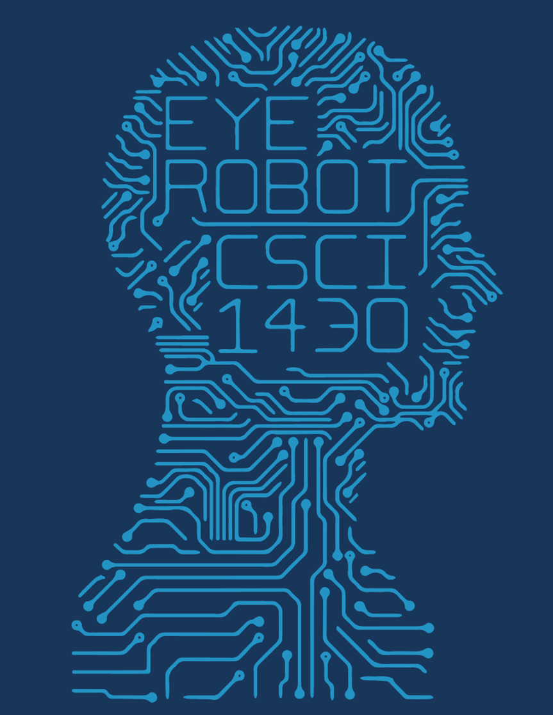
SuperZoom
Mary Dong, Peter Huson, Michael Litt, Gabe Weedon
Deep learning approach to finding missing resolution in images

Slide 2
Background:
We wanted to explore Up-Sampling images
Very cool applications

Slide 3
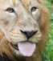
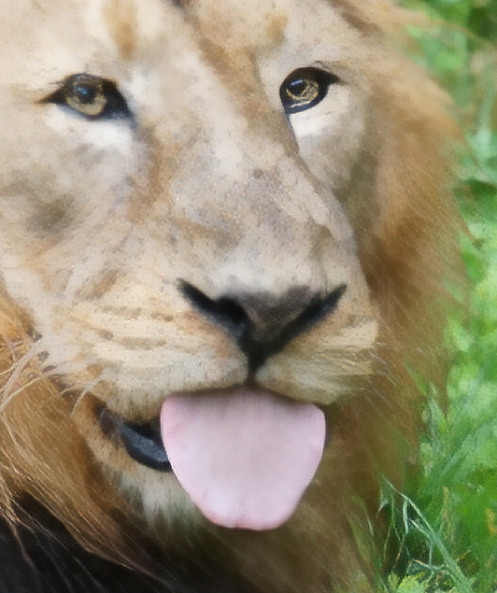
Industry Solution
ProSR/ProGanSR: Really good Network from 2018

Slide 4
Adversarial Testing
We tested the capabilities of the network:
Up-Sampled our own video to obtain more detail
We tested where the network fails:
Low-detail images
Low-contrast images
Textured Images
The Network Hallucinates:
Repeated Up-Sampling on input reveals some interesting patterns

Slide 5
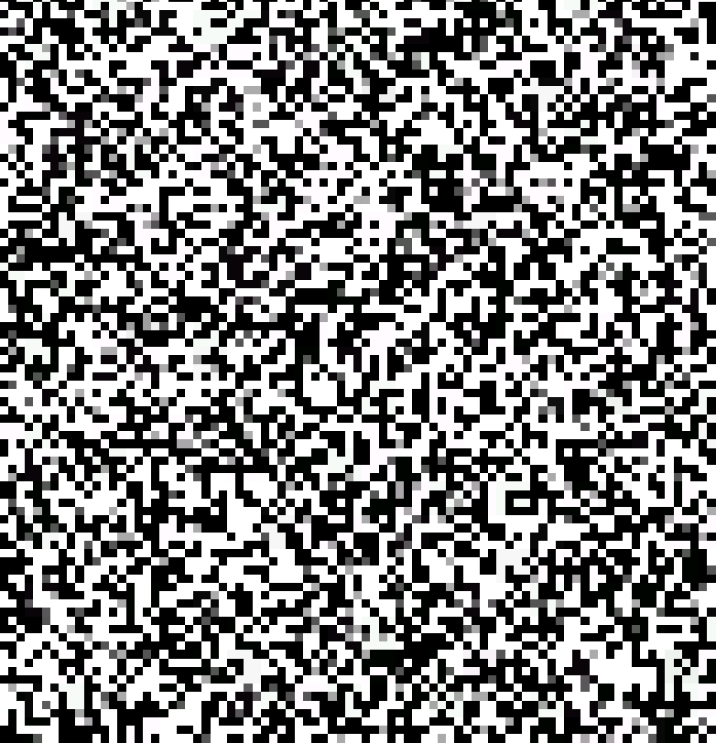
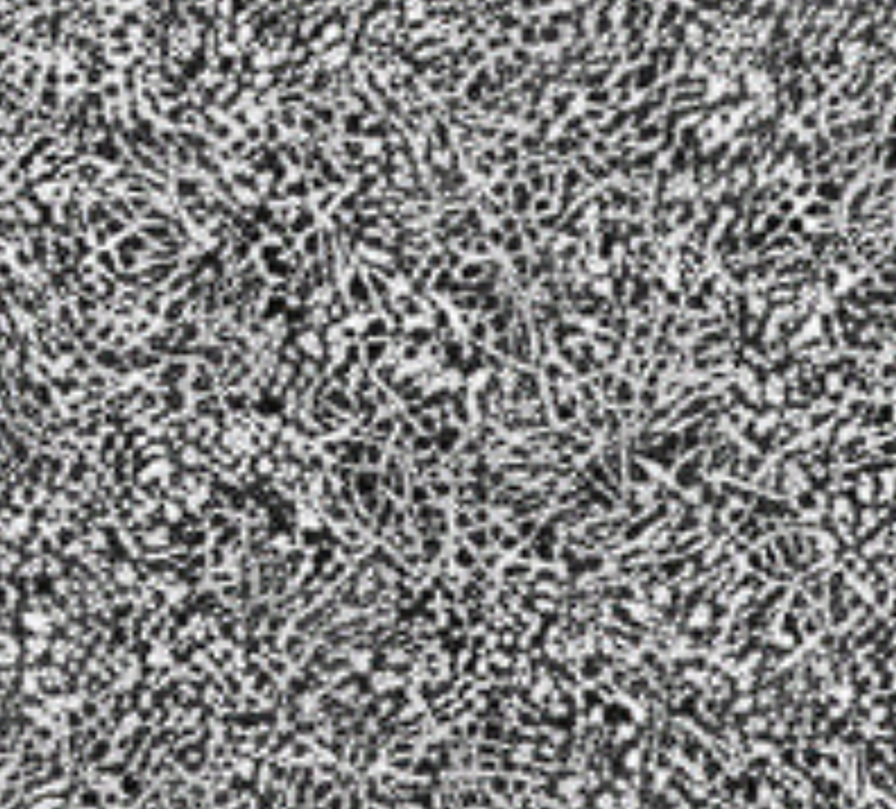
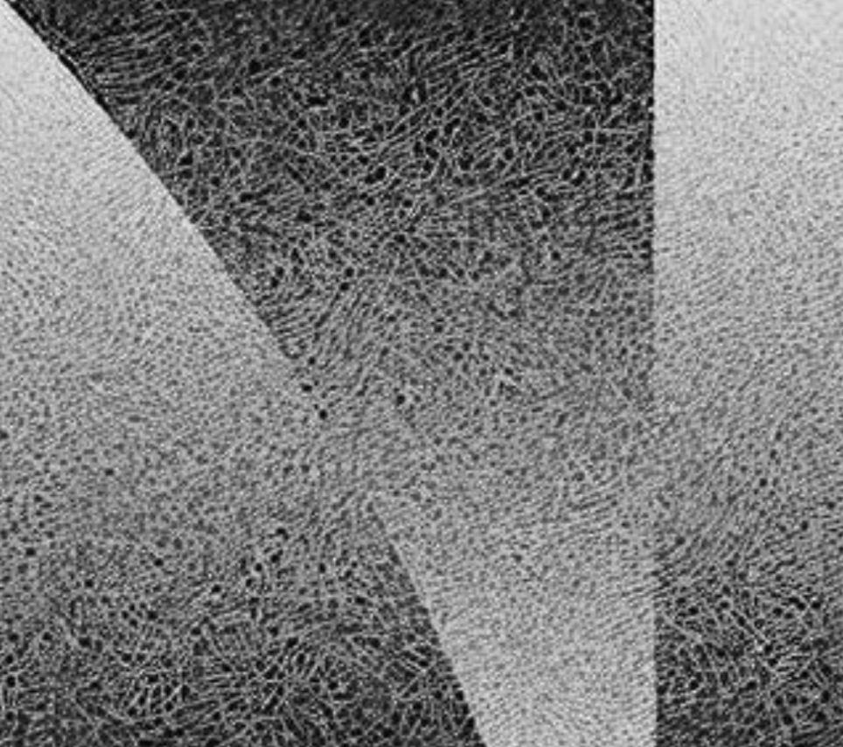
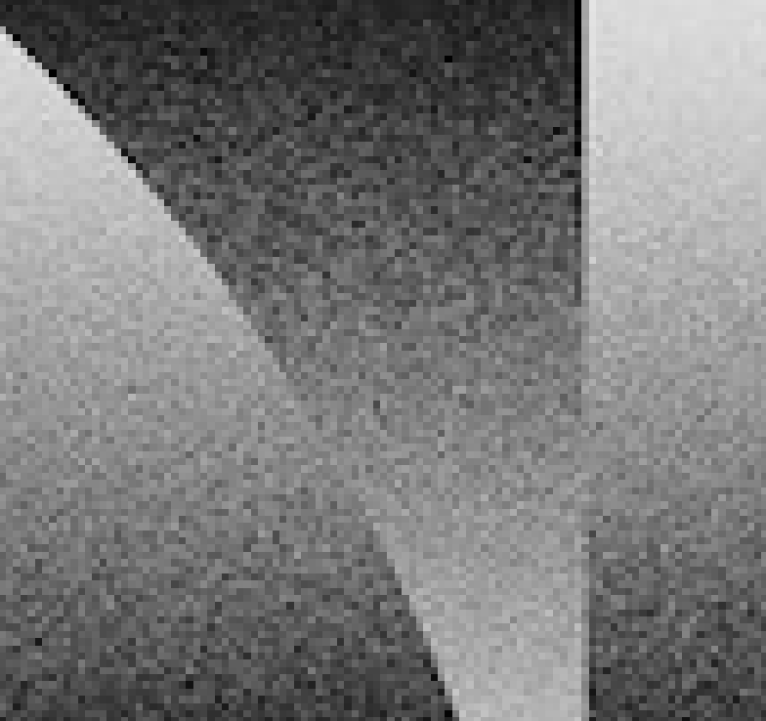
Network Hallucinations

Slide 6
Network Hallucinations

